Slide 1


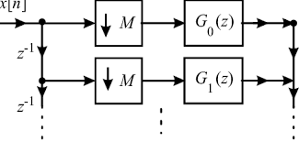
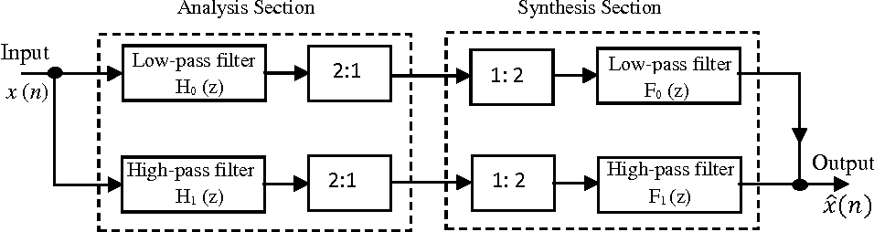

Implementation of a Two-Channel QMF Filter Bank
Based on Polyphase Structure
Mohammad Reza
Mansouri

Slide 2
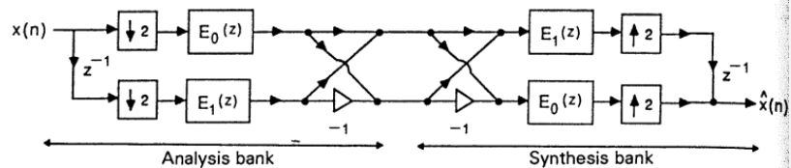
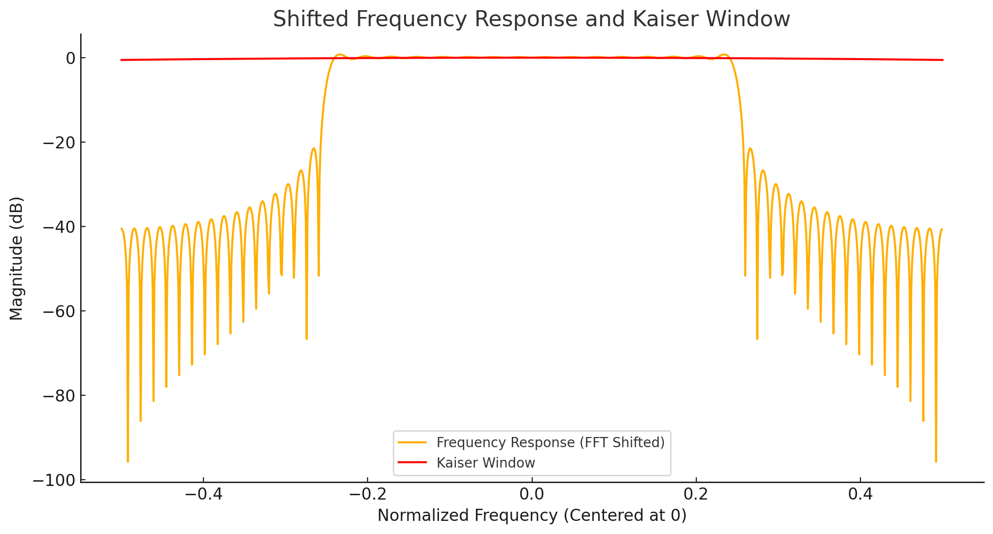
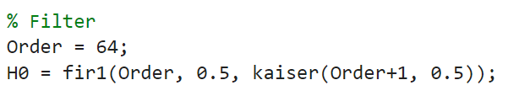
Introduction
1
In the simulation, for simplicity in design, coding is divided into two sections: analysis and synthesis.
First, we implement the initial filter, which is an FIR filter designed using a Kaiser window.

Slide 3
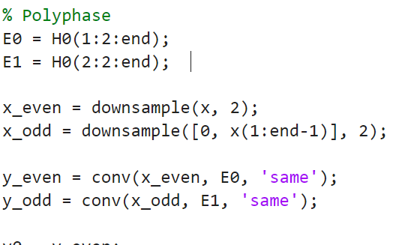
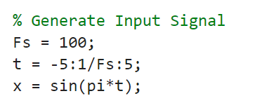

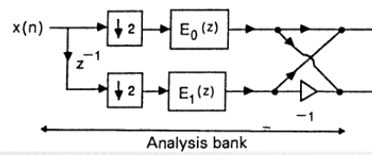
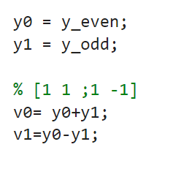
analysis
analysis
2
To reduce computational load, it is better
to implement the filters in a polyphase structure
y0
v0
y1
v1

Slide 4
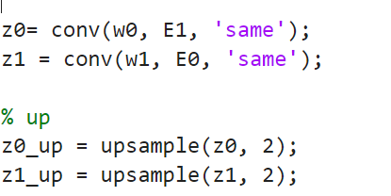
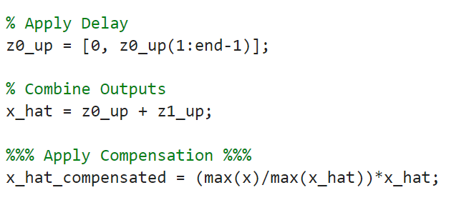
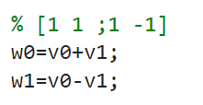
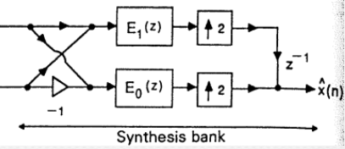
synthesis
2
w0
v0
v1
w1

Slide 5
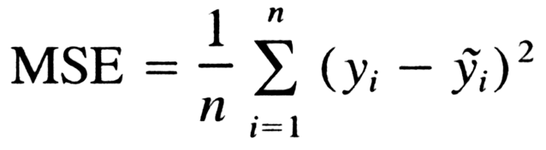

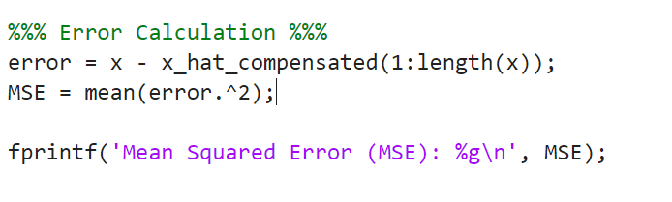
MSE
3

Slide 6

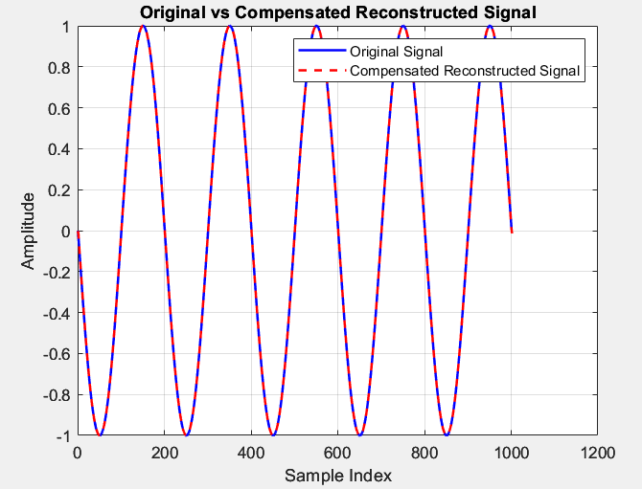
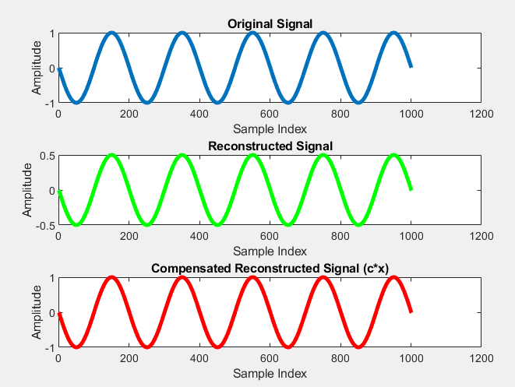
Results
3
The results are accurate, and the error between the input signal and the reconstructed signal is zero.

